Slide 1


OBJECTIVE:
Explore Stamp Registration, Transportation and TS-iPass Datasets.
Understand their attributes, categories and time period.
Analyze trends and patterns within each department.
Identify growth opportunities and areas needing attention.
Find correlation among these departments and report the overall growth of the state through insights and relevant visuals such as shape maps.
TELANGANA STATE
GROWTH ANALYSIS

Slide 2
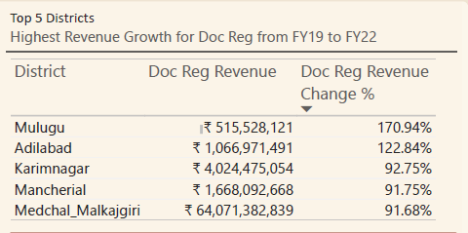
Stamp Registration
How does the revenue generated from document registration vary across districts in Telangana? List down the top 5 districts that showed the highest document registration revenue growth between FY 2019 and 2022.

Slide 3
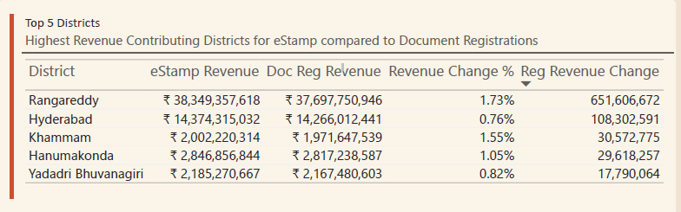
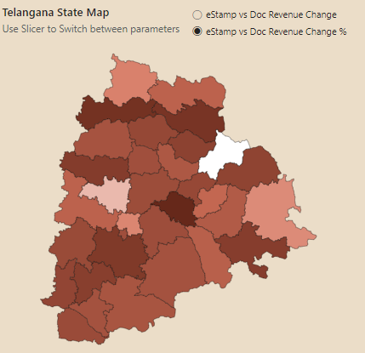
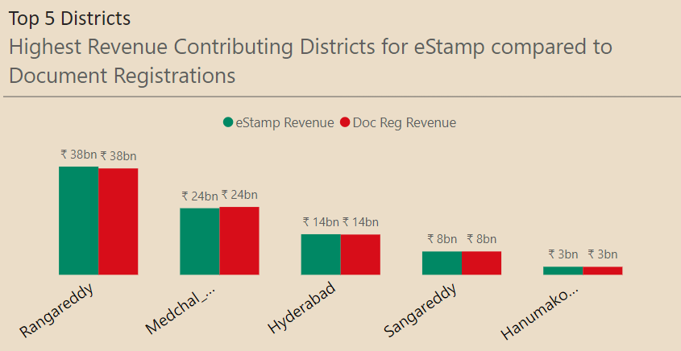
Stamp Registration
2. How does the revenue generated from document registration compare to the revenue generated from e-stamp challans across districts? List down the top 5 districts where e-stamps revenue contributes significantly more to the revenue than the documents in FY 2022?

Slide 4
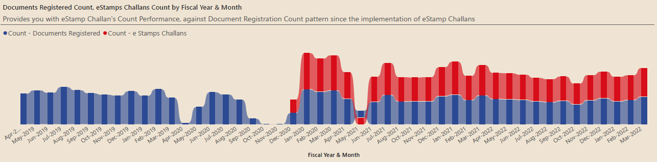
Stamp Registration
3. Is there any alteration of e-Stamp challan count and document registration count pattern since the implementation of e-Stamp challan? If so, what suggestions would you propose to the government?
By the introduction of e-Stamp Challans on Dec 2020, it has become the most preferred way of registrations for the people. But still we can see that the Document Registrations has also a place in overall registrations happening. Thus, the team could work on educating awareness on how the e-Stamps would be a time saver and beneficial over document registrations.

Slide 5
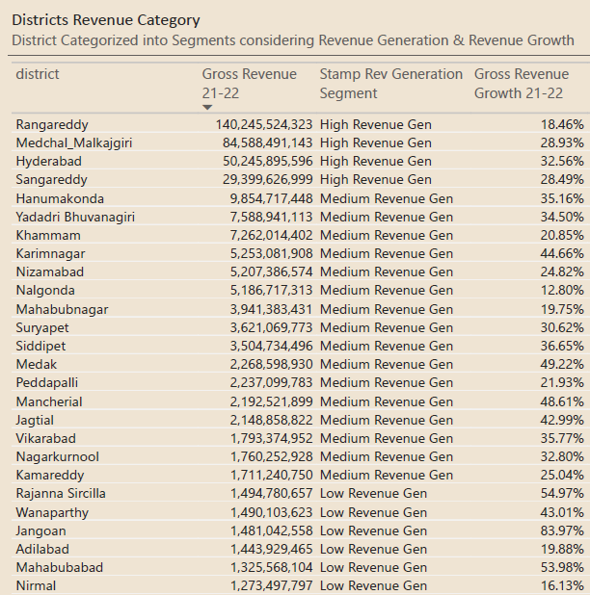
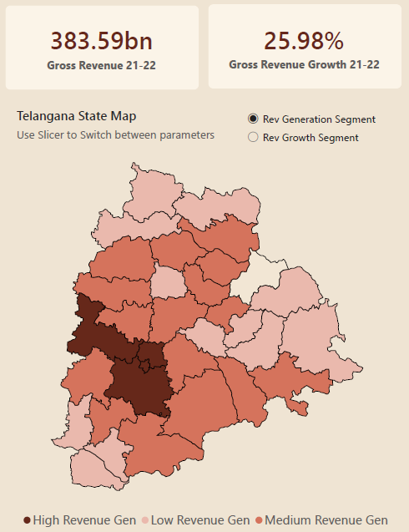
Stamp Registration
4. Categorize districts into three segments based on their stamp registration revenue generation during the fiscal year 2021 to 2022.

Slide 6
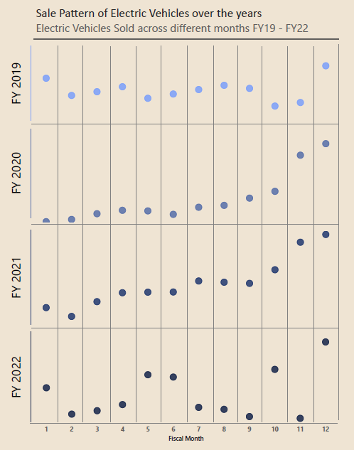
Transportation – Vehicle Sales
5. Investigate whether there is any correlation between vehicle sales and specific months or seasons in different districts. Are there any months or seasons that consistently show higher or lower sales rate, and if yes, what could be the driving factors? (Consider Fuel-Type category only)
Most vehicle sales of all fuel types has been observed in Hyderabad, Medchal-Malkajgiry & Rangareddy. As for electric vehicle sales, it has been noted that the sales are at peak by Feb-Mar months of all years. Also, the May-Jun months of the years are seeing a drop in sales consecutively. On FY22, there has been an e-Vehicle sales boom, which has resulted in higher sales even on other months. This has to be looked up on the coming years and we could identify if any of these trends continue.

Slide 7
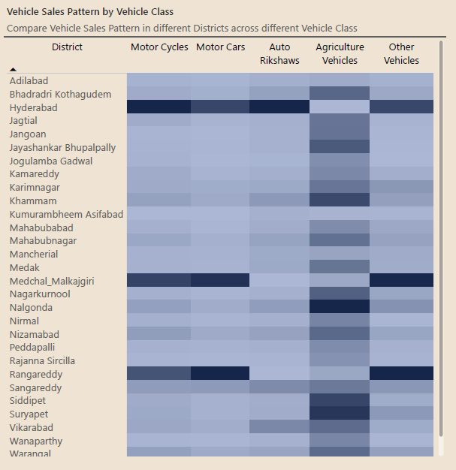
Transportation – Vehicle Sales
6. How does the distribution of vehicles vary by vehicle class (Motor Cycle, Motor Car, Auto Rickshaw, Agriculture) across different districts? Are there any districts with a predominant preference for a specific vehicle class? Consider FY 2022 for analysis.
Yes, it is clear that almost all districts have a high sales for Agricultural Vehicles, except that of Adilabad, Hyderabad, Asifabad, Macheriall, Medchal and Rangareddy. This can also be justified by seeing the preferred vehicle classes in Hyderabad, Medchal & Rangareddy. The sales are high for Motor Cycles, Motor Cars & Other Vehicles in these districts compared to other districts.

Slide 8
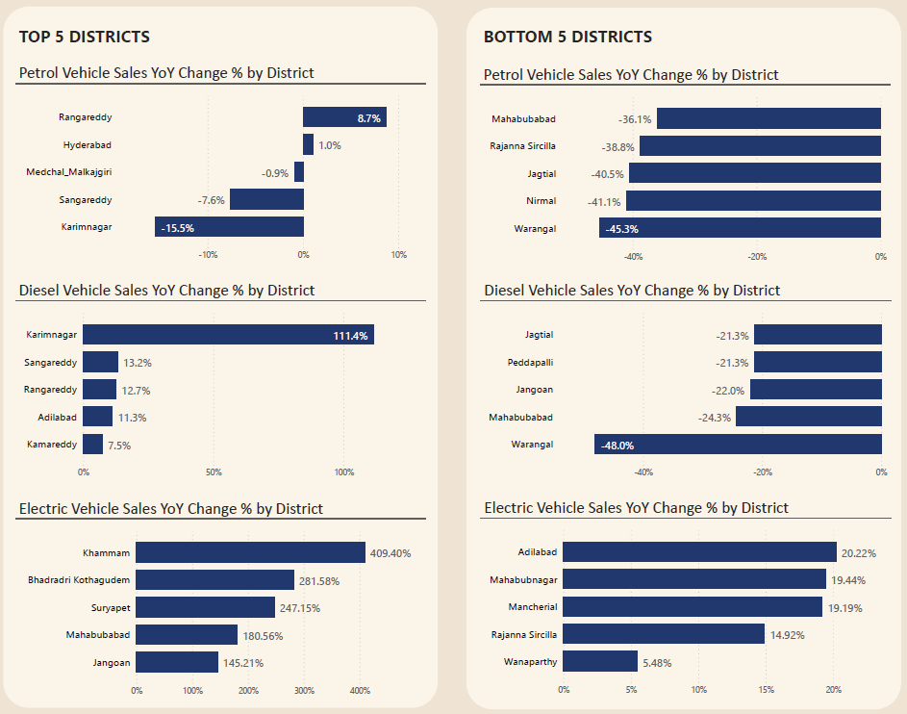
Transportation – Vehicle Sales
7. List down the top 3 and bottom 3 districts that have shown the highest and lowest vehicle sales growth during FY 2022 compared to FY 2021? (Consider and compare categories: Petrol, Diesel and Electric)

Slide 9
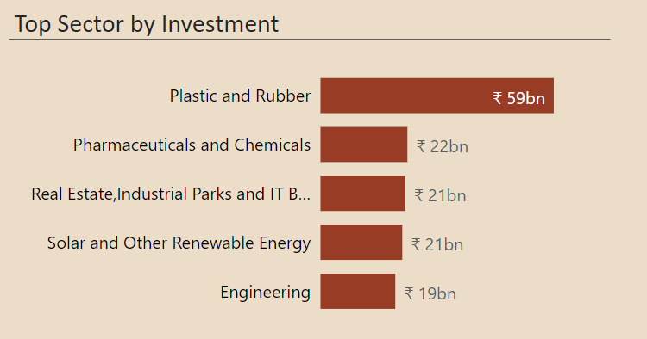
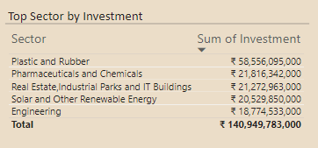
TS-iPass (Telangana State Industrial Project Approval and Self Certification System)
8. List down the top 5 sectors that have witnessed the most significant investments in FY 2022.

Slide 10
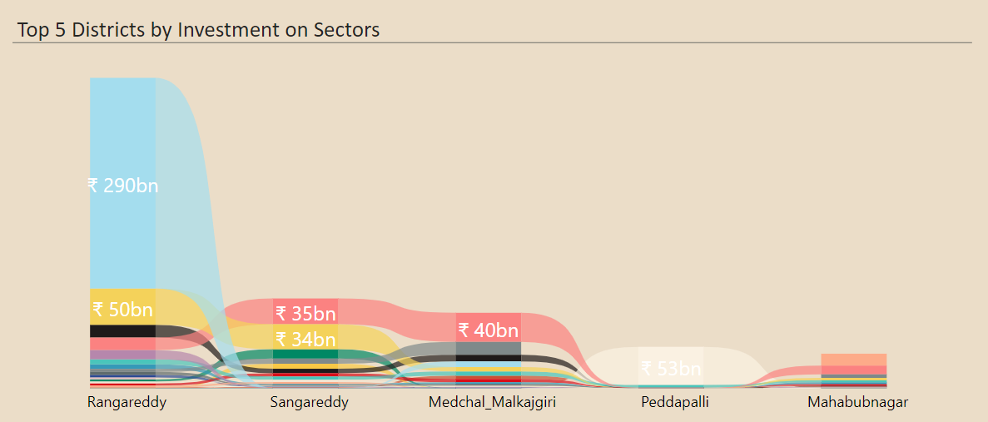
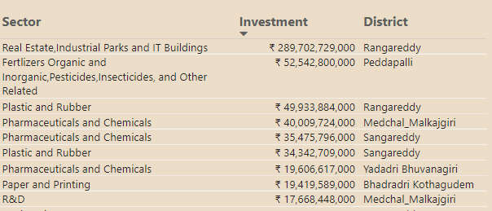
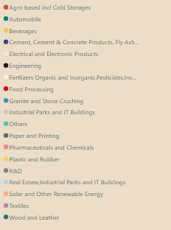
TS-iPass (Telangana State Industrial Project Approval and Self Certification System)
9. List down the top 3 districts that have attracted the most significant sector investments during FY 2019 to 2022? What factors could have led to the substantial investments in these particular districts?
Most valued investments have been seen for sectors in the table in order. As generally known, Rangareddy is specifically known for the Real Estate, IT Parks & Industrial Parks. Also, its generally observed that the Telangana State has been a hub for Pharmaceuticals & Chemical Industries.

Slide 11
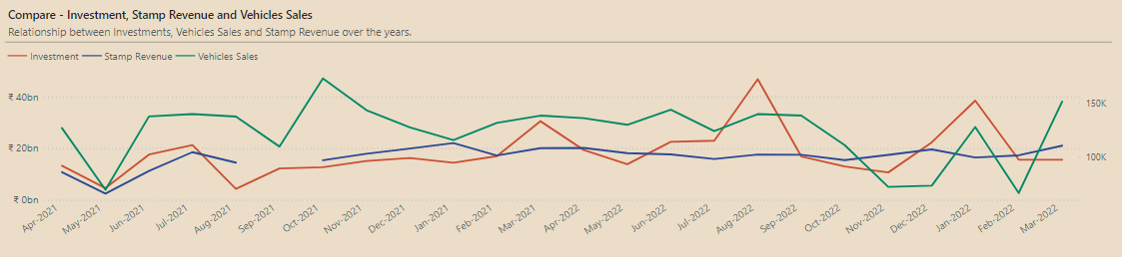
TS-iPass (Telangana State Industrial Project Approval and Self Certification System)
10. Is there any relationship between district investments, vehicles sales and stamps revenue within the same district between FY 2021 and 2022?
It can be seen that at times, there is a direct relation between investment and vehicle sales, as some months shows dip in both vehicle sales & investments together and the same can be observed for high’s.

Slide 12
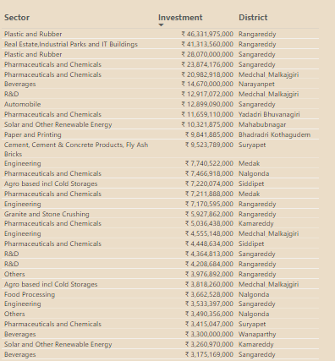
TS-iPass (Telangana State Industrial Project Approval and Self Certification System)
11. Are there any particular sectors that have shown substantial investment in multiple districts between FY 2021 and 2022?
Textiles, Wood & Leather, Plastic & Rubber, Pharmaceuticals & Chemicals, Engineering, Beverages, Agro Based Incl Cold Storage and R&D Are the most seen sectors with substantial investment in multiple districts between FY2021 & FY2022

Slide 13
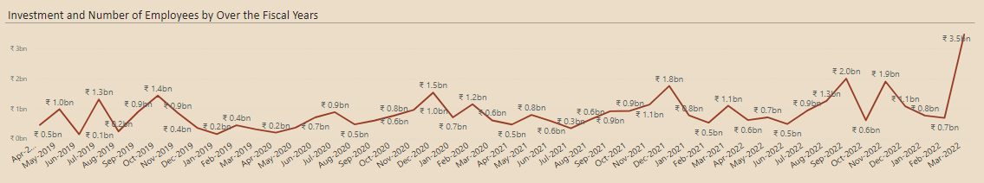
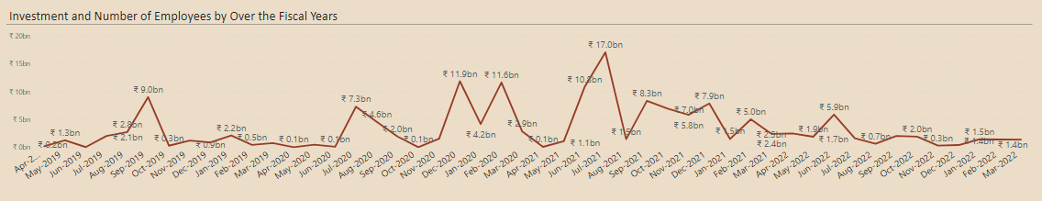
TS-iPass (Telangana State Industrial Project Approval and Self Certification System)
12. Can we identify any seasonal patterns or cyclicality in the investment trends for specific sectors? Do certain sectors experience higher investments during particular months?
Food Processing
Pharmaceuticals & Chemicals
Food Processing, Pharmaceuticals & Chemicals, Wood & Leather are the sectors which could be seen with investments all throughout the year.

